Slide 1
REIVON
Reduction of the Environmental Impact of aviation via Optimisation of aircraft size/range and flight Network
Type of funding: Research and Innovation Actions, RIA; Programme Area: TE
Call Title: Reduction of the environmental impact of aviation via optimisation of aircraft size/range and flight network
Call Identifier: JTI-CS2-2020-CfP11-TE2-01-14
Presentation to CAEP/13-WG2/2-IP/XX
Presented by Thomas Rötger (Switzerland)
Consortium: ENVISA, TAKS, MMU, TUHH

Slide 2




Project Structure and Objectives
REIVON is a Clean Sky 2 Technology Evaluator project
Project duration: January 2021 – June 2023 (30 months)
Partners:
Objective:
  Investigate to what extent CO₂ emissions of global aviation can be reduced via optimisation of aircraft size/range and flight network, addressing a given demand, through:
  1) splitting long-haul flights into shorter legs;
  2) reducing frequencies to the necessary minimum; and
  3) a combination of 1 and 2
  with related aircraft design range/size optimisation, including aircraft not existing today
supported by Clean Sky Topic Manager:

Slide 3

REIVON Main Approach 1:
Split long-haul flights into shorter legs
(intermediate stop operations = ISO)
B
B
C
C
A
A
Split flight with same aircraft
☺
Avoid «burning fuel to carry fuel»
Split flight with optimised aircraft
☺
As before +
Use optimised range aircraft
(lighter design)
☹
Additional fuel for second take-off
Investigate CO₂ savings and possible intermediate stops
Stakeholder impacts: airlines, airports, ANSPs, passengers, manufacturers, airport neighbours
3

Slide 4
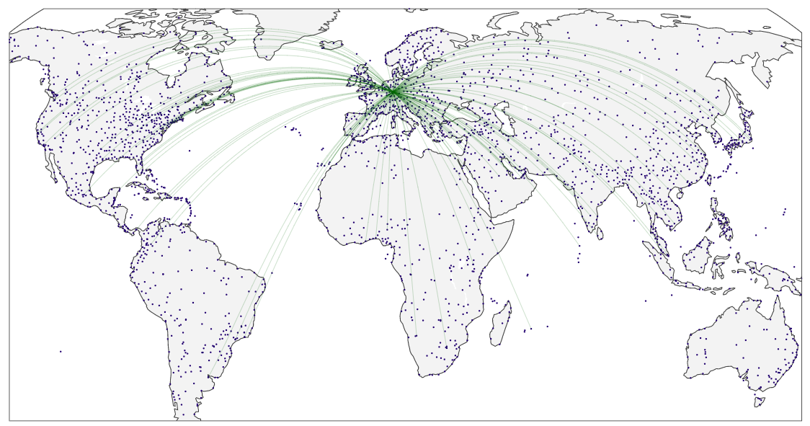
Direct flights from FRA – original

Slide 5
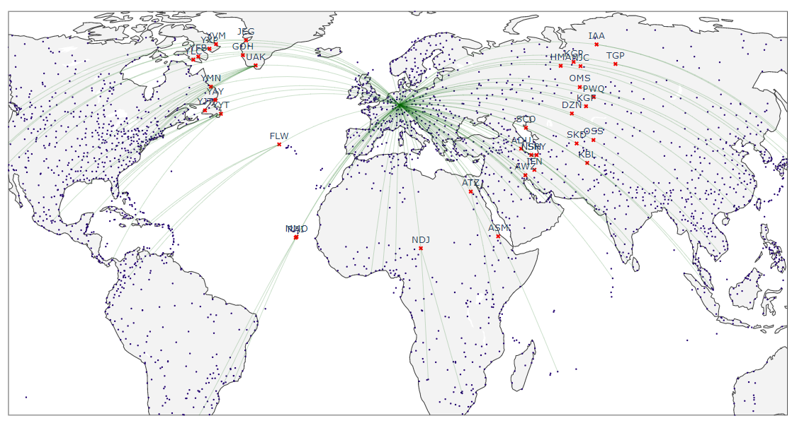
FRA Flights with 100% ISO
(≥ 3000 NM)
Routes ≥ 3000 NM + ISO at the closest airport to the midpoint of Origin & Destination

Slide 6

REIVON Main Approach 2:
Fly size/range-optimised aircraft with reduced frequencies
Fewer flights with larger aircraft
?
Total fuel burn depends on aircraft characteristics
☺
Less fuel with size- and range-optimised aircraft
Investigate CO₂ savings for optimised aircraft designs (short range, high capacity – “people mover”)
Consider for routes with ≥ 500,000 available seats/year
Stakeholder impacts: airlines, airports, ANSPs, passengers, manufacturers, airport neighbours
6

Slide 7
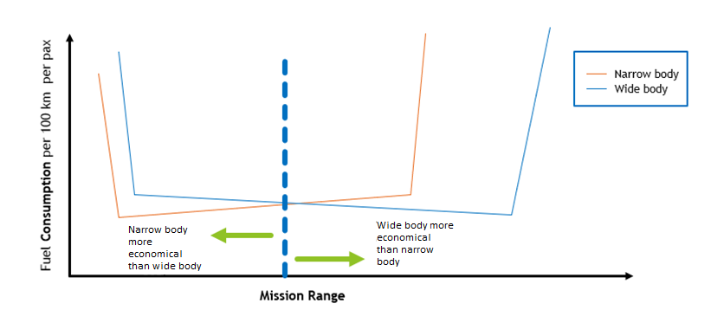
General principle for new aircraft design in REIVON
Figure shows the relationship between fuel efficiency and mission distance for narrow body (e.g. A320) and wide body (e.g. B777)
It does not mean ‘put passengers in the largest aircraft possible’, but, ‘put passengers in the largest aircraft most suited for the mission distance’

Slide 8
‘New’ Aircraft Design approach
New aircraft generated to cover 7 different design ranges, from 1000 to 7000 NM
Seat capacity definitions assumed to be the same as maximum aircraft seat capacities in forecast model
Number of Seats | Aircraft in DLR Unconstraint Forecast for REIVON
138 | Airbus A319
163 | Airbus A320
163 | Airbus A320neo
193 | Airbus A321
193 | Airbus A321neo
255.5 | Boeing 787-8
350.5 | Airbus A350-900
450.5 | Boeing 747-8I
450.5 | Boeing 777-9
550.5 | Airbus A380-800
Maximum number of seats assumed for existing fleet in global forecasted air traffic data

Slide 9
‘New’ Aircraft Design process
Aircraft Class* and Reference Aircraft
Design Range (DR)
Seating Capacity (SC)
NASA FLOPS**
Aircraft Class | Reference Aircraft Type
Single Aisle | A320-200N
Twin Aisle (> 250) | Boeing 787-9
Calibrate Aircraft Design Model
Set of Aircraft Design with new TLARs
Performance Off-design mission (OFF)
3D Matrix
Fuel Consumption & Flight Time
for new aircraft design
* Based on maximum number of seats and aisle category
** Multi-disciplinary system for preliminary aircraft design
TLARs: Top-Level Aircraft Design Requirements

Slide 10
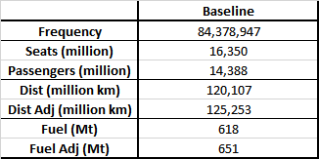
CO₂ calculation assumptions
Aircraft emissions model: FAST with PIANO aircraft performance model
Great circle distances assumed, and where applicable, CAEP-like adjustment factors applied (e.g. distance and/or fuel adjustment factors to account for flight inefficiencies)
Baseline schedule passenger results for 2050 (unconstrained high demand before optimisation)

Slide 11
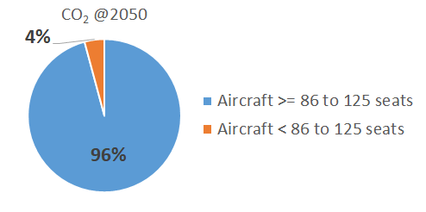
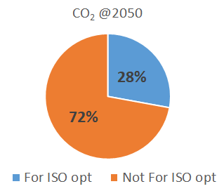
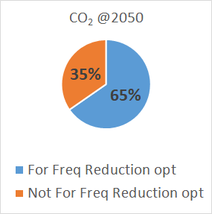
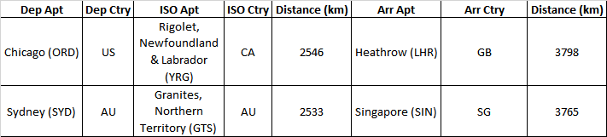
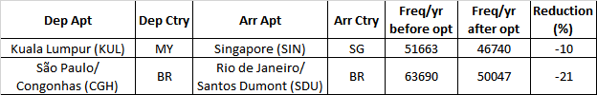
Optimisation assumptions
ISO
Frequency Reduction
Routes with aircraft equivalent or larger than 86 to 125 seats
  Routes with Range >= 3000 NM
  ISO legs >= 20% of route distance
  No change to route frequency
  after optimisation
  Example routes:
  Routes with >= 500,000 seats
  Routes with >= 3 flights per day
  Airport capacity not considered
  Example routes:
Number of ‘new’ aircraft type limited to a maximum of 5 per seat category

Slide 12
Impact assessment for stakeholders:
Airports and airport neighbours
5 to 10 airports being selected for detailed impact studies:
  hubs with busy routes
  ISO stops
  already affected by noise, pollutant emissions and/or congestion
Impact studies (application of REIVON measures vs reference)
(final selection once route optimisation validated)
Noise
L_{den} contours for baseline and forecast years
Change in contour shape and size
Local air quality
Emission inventories in LASPORT
Consider engine emissions indices for future aircraft
Airport capacity
Airside aircraft flow
Terminal passenger flow
Landside vehicle flow
etc.

Slide 13
Impact assessment for stakeholders:
Air transport system
Assessment of impacts of the REIVON measures for main stakeholders of air transport system, using the AERO-MS model
Most metrics will be assessed both on a global level and split out by route group. Aircraft fleet metrics also split out by seat/range bands
The required number of aircraft not yet existing will be computed, and a qualitative assessment will be made whether these can be available in time taking into account development, certification and production of new aircraft (especially relevant for the scenario year 2035)
Passengers
Number of direct connections
Flight frequency per airport pair
Travel costs (qualitative)
Travel time per trip
Airlines
Number of passengers
Number of pax-km
Impact on airline revenues (qualitative)
Aircraft manufacturers
Aircraft fleet
New aircraft productions
Air traffic management
Number of movements
Airspace congestion
Stakeholder input through Advisory Board

Slide 14
Conclusions and Outlook
Currently, global flight network and aircraft choice per route not optimised for overall emissions reduction
Objective of REIVON: Investigate to what extent the CO₂ emissions of global aviation can be reduced via an optimisation of aircraft size/range and flight network
Preliminary modelling results show:
  Combination of ISO and frequency reduction and aircraft optimisation gives substantial improvements
  These require aircraft not existing today
Numerous stakeholders impacted (airports + neighbours, passengers, airlines, ATM, manufacturers)
  in first approach more negatively than positively
But the environmental effectiveness of the concept should open new perspective of rethinking the whole network structure and aircraft fleet

